Slide 1

OPTICAL FLOW TO TRACK AND DETECT CAR SPEED
Abhijit Mahalle (117472288)
Pradip Kathiriya(117678345)
Jeffin Kachappilly(118293929)

Slide 2
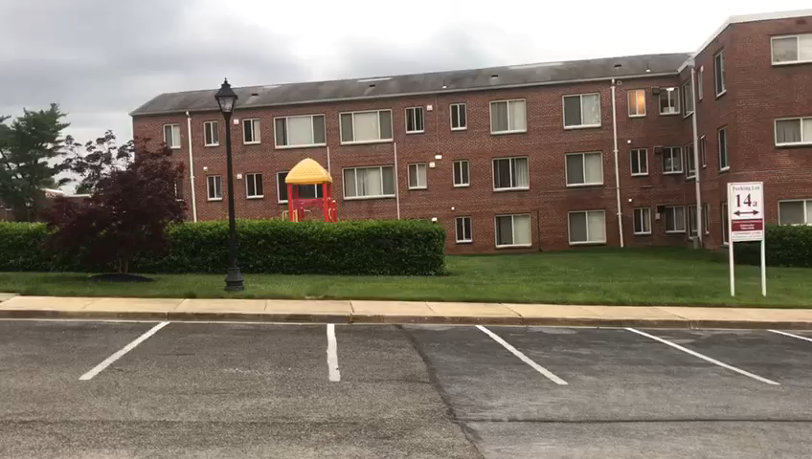
Introduction
Problem: Detect and measure the speed of the vehicle using optical flow
Input: Video of passing by vehicle taken from the side
Output: Video tracking and showing the speed of the vehicle measured in mph.

Slide 3
BackGround & LITERATURE REVIEW
What is optical flow?
Optical flow is the pattern of apparent motion of image objects between two consecutive frames.
Classical approach:
Dense optical flow
Lucas Kanade
Horn and Schunck
Deep Learning approach:
Most of the work has been associated with dashcam videos.

Slide 4
Computer vision pipeline
1. Input video
2. Read two consecutive frame
3. Pre-Processing
4. Detect vehicle by detecting contour
9. Measure speed
7. Feature displacement
6. SIFT to detect feature
5. region of interest(ROI)
8. Measure pixel/mm by taking reference in the scene

Slide 5
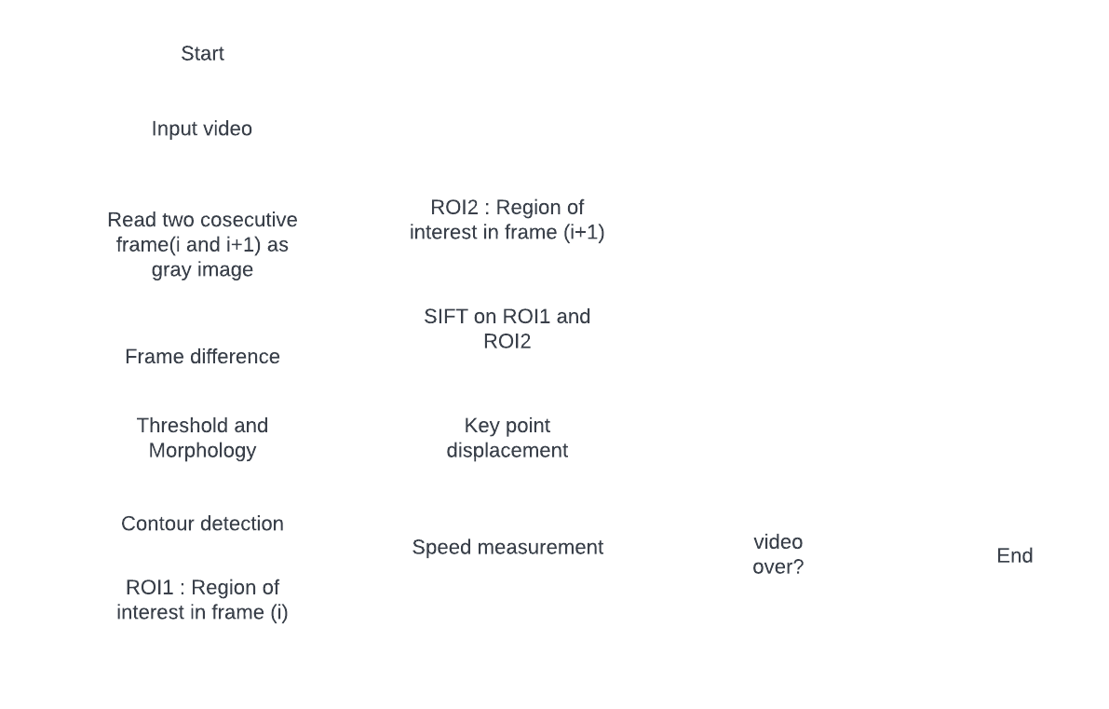
Flow Chart

Slide 6


Result
Intermediate Result:
Fig. 1: Difference between two consecutive frames
Fig. 2: Thresholding and morphological closing

Slide 7
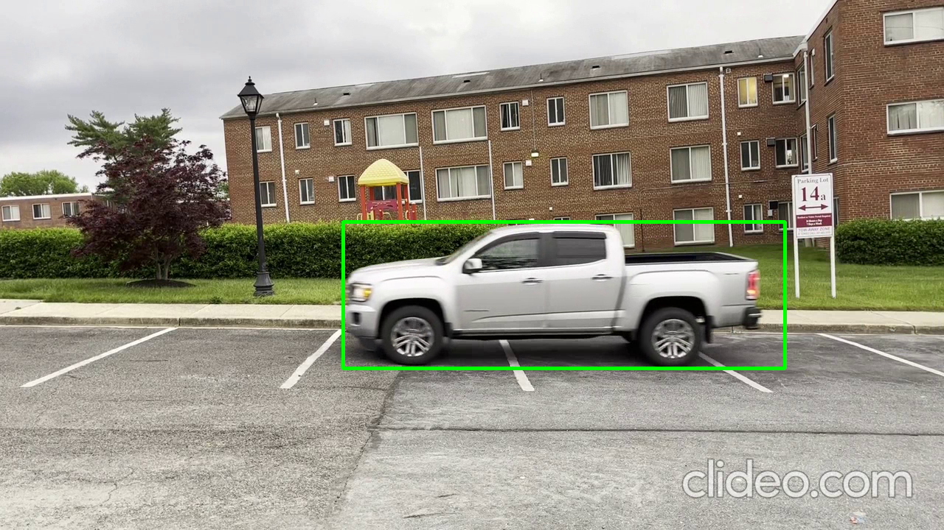
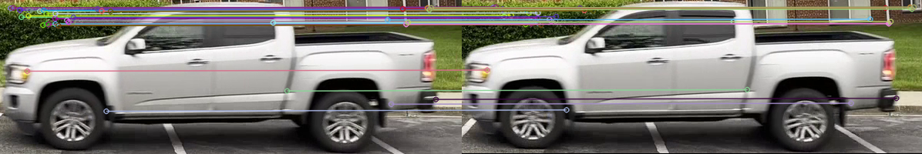
Result
Intermediate Result:
Fig. 3: Detecting vehicle using contours
Fig. 4 : SIFT in ROI

Slide 8

Result cont.
Video 1: Vehicle Speed – 10 MPH

Slide 9
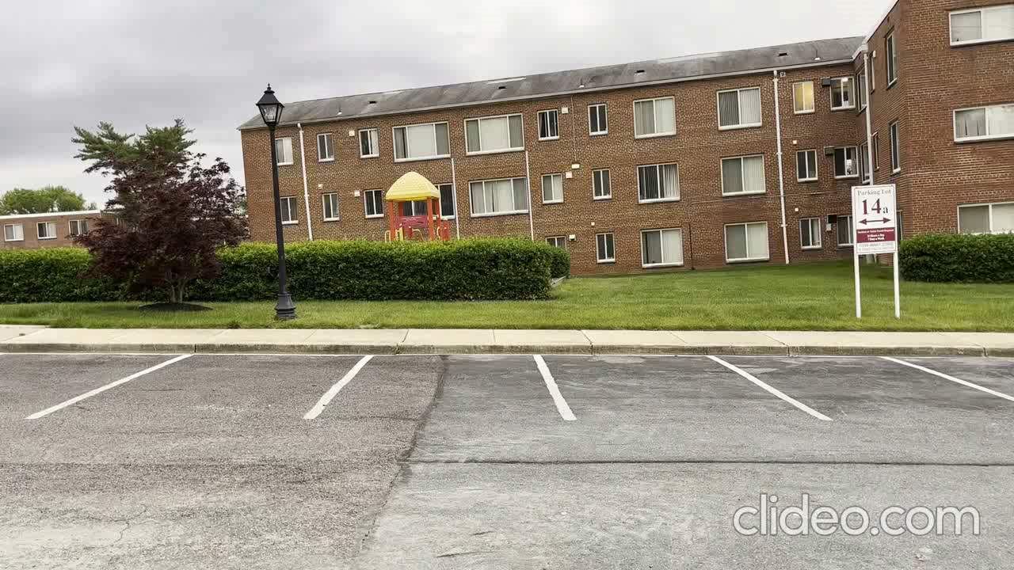
Result cont.
Video 2: Vehicle Speed – 20 MPH

Slide 10
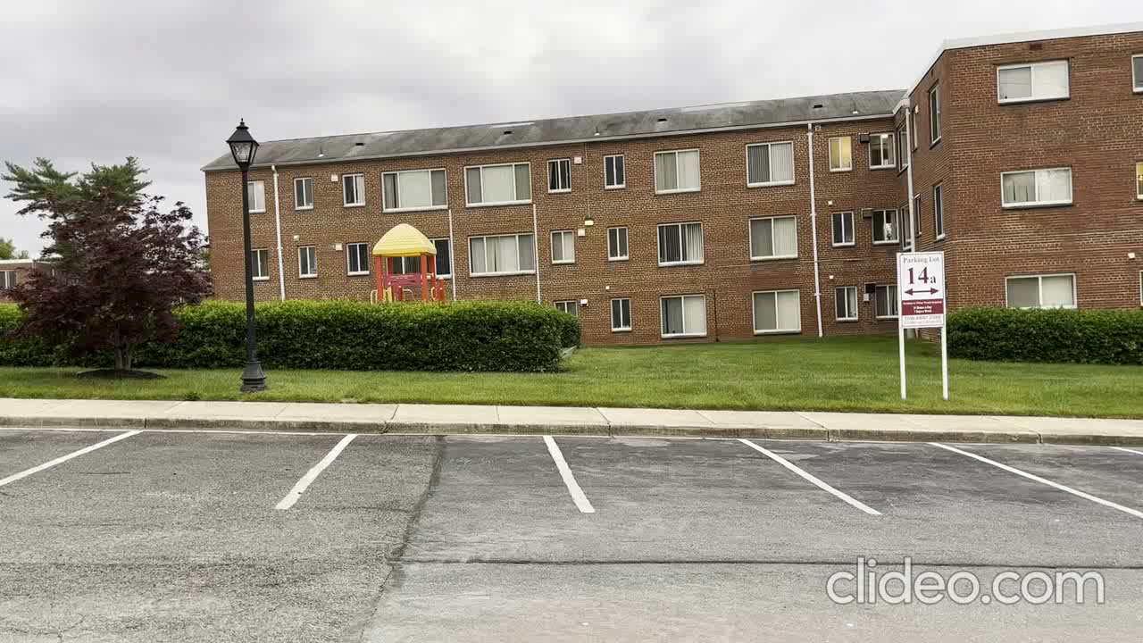
Result cont.
Video 3: Vehicle Speed – 25 MPH

Slide 11
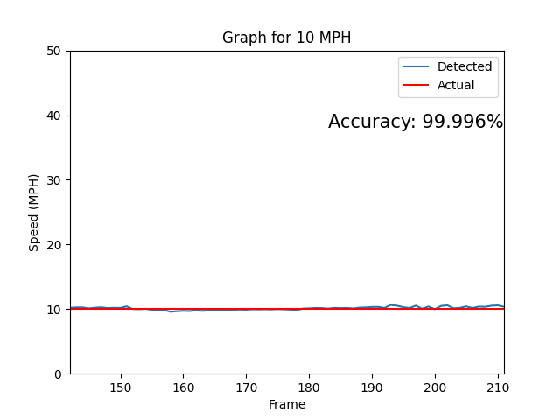
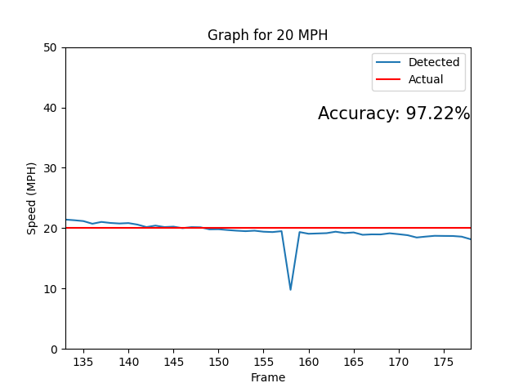
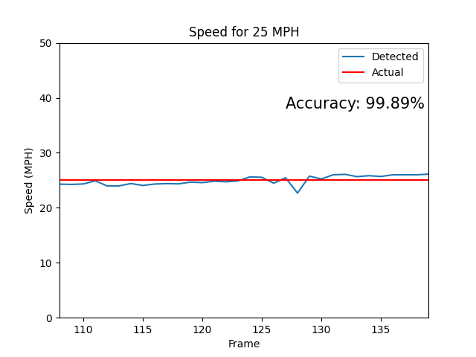
Result cont.
Comparison with actual speed

Slide 12
limitations
There must be only one vehicle in the video.
Camera must capture the vehicle from the side and not from the front and back.
Longitudinal plane (Sagittal plane) of the vehicle must be perpendicular to the optical axis of the camera.
The perpendicular distance between the camera’s coordinate frame and the longitudinal plane of the vehicle must remain constant.
Vehicle must have some feature that can be detected using a feature detector.

Slide 13
Conclusion
Developed and implemented a pipeline to detect the vehicle and measure its speed using Sparse Optical Flow.
Detected the speed of the vehicle moving with three different speeds of 10 mph, 20 mph, and 25 mph with an accuracy of 99.99%, 97.22%, and 99.98% respectively.

Slide 14
What we have learned?
Optical flow theory
Application of optical flow to detect the speed using the Lucas-Kanade method.
Application of optical flow to detect the speed using feature matching technique.
Procedure to pre-process the images for optical flow application.

Slide 15
Thank you!
Questions?

